Slide 1

Module 2
Exploratory Data Analysis (EDA)
Notes:
Guidelines
Use section headers to chunk content in your presentation.
Use the same style of section header throughout your presentation.
Keep your title to no more than 2 lines.

Slide 2

EDA – Summaries and Basic Plots
Notes:
Guidelines
Use a title slide at the beginning of your presentation. There are 9 variations of title slides to choose from.
If you will have a series of slideshows, we recommend using the same style of title slide for each presentation.
Keep your title to no more than 2 lines.
Do not change the font style or font size of the title or subtitle.

Slide 3
Purpose of Exploratory Data Analysis
Analyzing variables individually (univariate)
  Number of variables
  Categorical variables with too many levels
  Categorical variables with 1 level
  % of missing values
  Summary statistics
  Data shapes
  Variable types
  Variables to remove for irrelevance
  Extreme values

Slide 4
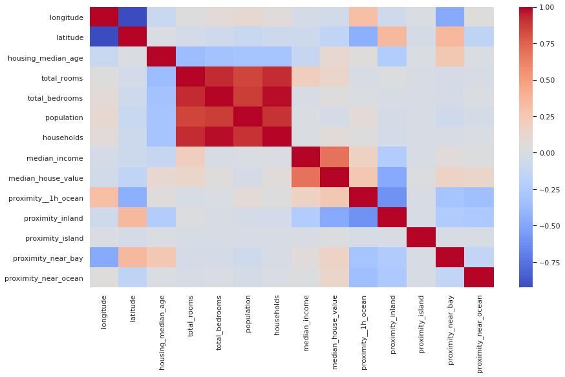
Purpose of Exploratory Data Analysis
Analyzing joint relationships (multivariate)
  Relationships with response
  Multi-collinearity

Slide 5

Veterans Data
A national veterans’ organization seeks to better target its solicitations for donation.
Goal: solicit the most likely donors
Solicitations involve sending a small gift
The organization has more than 3.5 million individuals in database

Slide 6
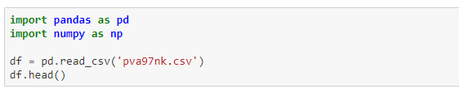
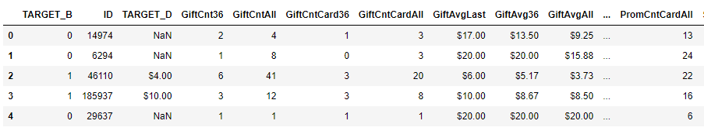
Veterans Data
Dataset:

Slide 7
Correcting Variable Types
Notes:
Guidelines
Use a title slide at the beginning of your presentation. There are 9 variations of title slides to choose from.
If you will have a series of slideshows, we recommend using the same style of title slide for each presentation.
Keep your title to no more than 2 lines.
Do not change the font style or font size of the title or subtitle.

Slide 8
Variable Types Check
Check that each variable is stored in the appropriate data type
  Numeric → int or float
  Categorical → object / category
  Dates → datetime
Common problems
  $45,000 stored as object or text instead of numeric
  Category codes such as 1, 2, 3 treated as continuous numbers
Example from Veterans data
  DemMedIncome: remove $ and convert to numeric
  DemCluster: numeric codes represent categories, so treat as categorical

Slide 9
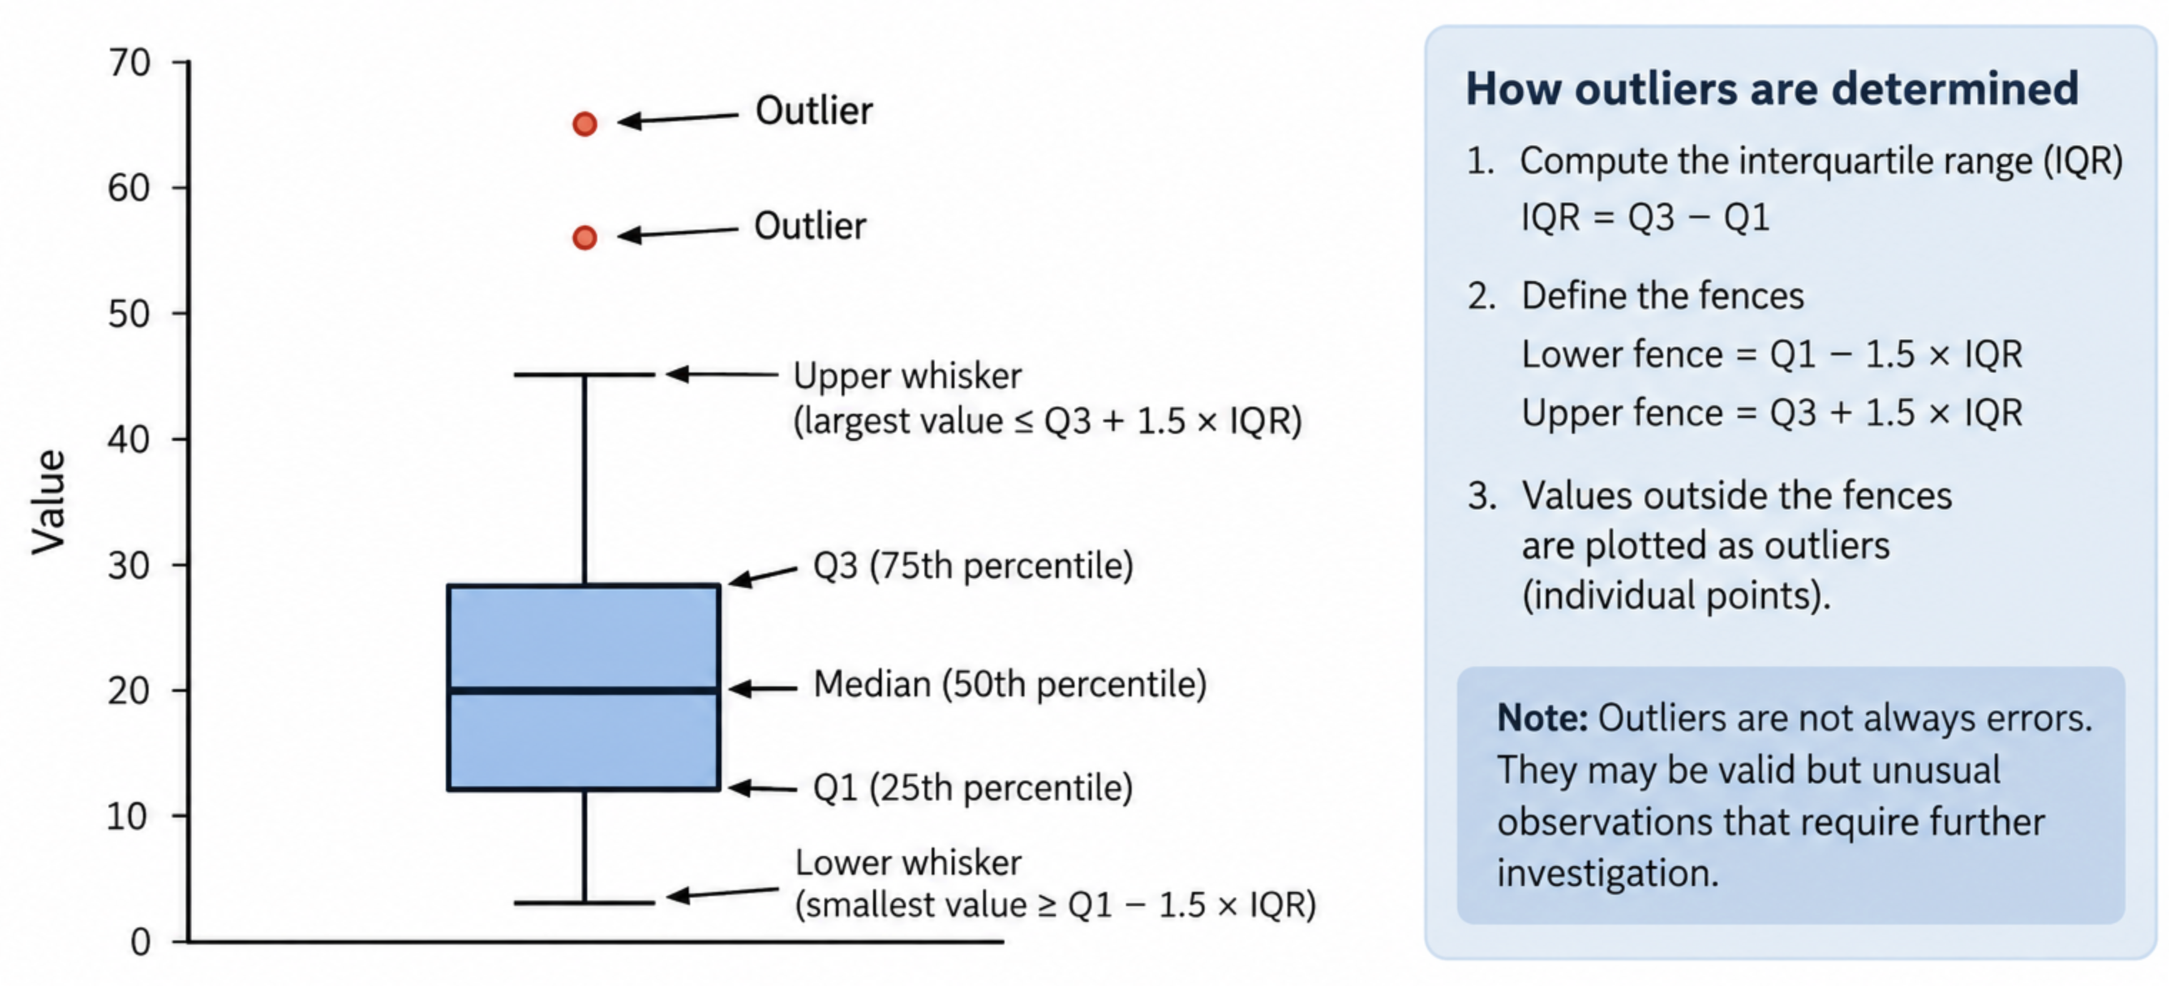
Outliers / Anomalies
Check that each variable is stored in the appropriate data type

Slide 10
Numeric Variable Summaries
Notes:
Guidelines
Use a title slide at the beginning of your presentation. There are 9 variations of title slides to choose from.
If you will have a series of slideshows, we recommend using the same style of title slide for each presentation.
Keep your title to no more than 2 lines.
Do not change the font style or font size of the title or subtitle.

Slide 11
Summaries of Numeric Variables
Summarize the data
  Mean, median, standard deviation
  Min, max, and quartiles
Examine distributions
  Histograms
  Boxplots
Look for potential issues
  Skewness
  Unusual/extreme values
  Unexpected zeros or ranges
  Missing values
Goal: Understand the behavior of numeric variables before modeling.

Slide 12
Numeric Variable Summaries
Notes:
Guidelines
Use a title slide at the beginning of your presentation. There are 9 variations of title slides to choose from.
If you will have a series of slideshows, we recommend using the same style of title slide for each presentation.
Keep your title to no more than 2 lines.
Do not change the font style or font size of the title or subtitle.

Slide 13
Cardinality
Cardinality = number of unique levels in a categorical variable
Low cardinality: few categories
  Gender: Male, Female
High cardinality: many categories
  DemCluster: 54 levels
Why does it matter?
  Dummy encoding can create many new variables
  Increases model complexity
  May lead to sparse data and overfitting
Key takeaway:
  Check the number of levels before encoding a categorical variable.

Slide 14
Model Degrees of Freedom
Notes:
Guidelines
Use a title slide at the beginning of your presentation. There are 9 variations of title slides to choose from.
If you will have a series of slideshows, we recommend using the same style of title slide for each presentation.
Keep your title to no more than 2 lines.
Do not change the font style or font size of the title or subtitle.

Slide 15
Model Degrees of Freedom
Model Degrees of Freedom & Complexity
Degrees of freedom (df) ≈ number of parameters a linear model must estimate
More predictors → more parameters → greater model complexity
Categorical variables add multiple parameters
  k categories → typically k-1 dummy variables
  Example: DemCluster with 54 levels → 53 df
Why does complexity matter?
  More data may be needed
  Models can become harder to interpret
  Too much complexity can increase overfitting
Key takeaway:
  More variables are not always better—balance predictive information with model complexity.

Slide 16
Relationships
Notes:
Guidelines
Use a title slide at the beginning of your presentation. There are 9 variations of title slides to choose from.
If you will have a series of slideshows, we recommend using the same style of title slide for each presentation.
Keep your title to no more than 2 lines.
Do not change the font style or font size of the title or subtitle.

Slide 17
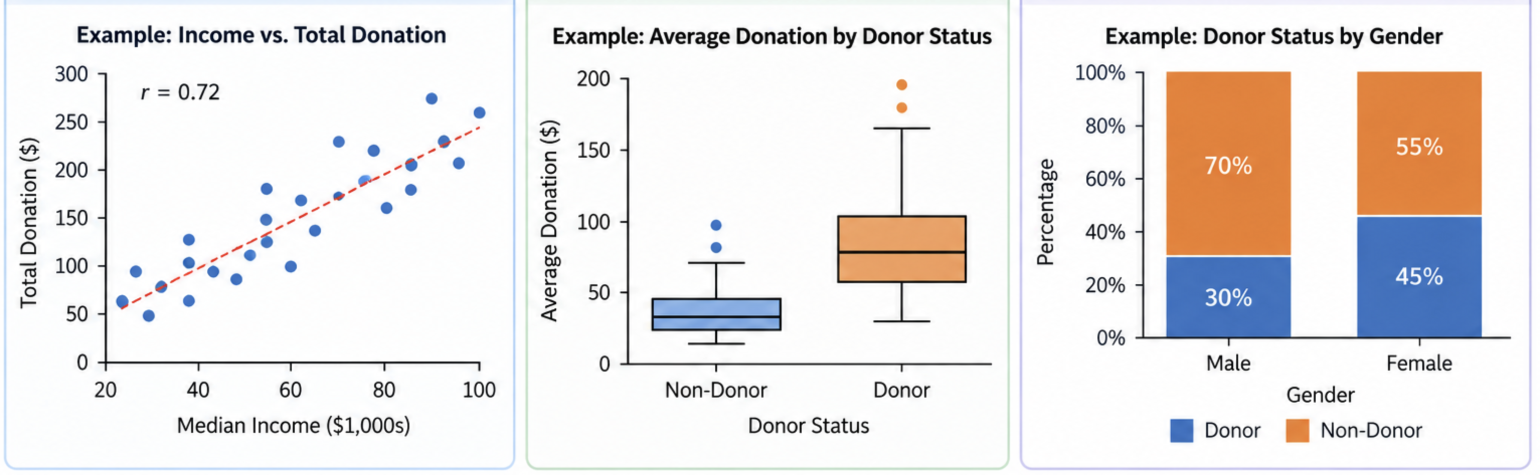
Model Degrees of Freedom
Variable Types | What to Examine | Useful Tools
Numeric ↔ Numeric | Direction, strength, unusual patterns | Scatterplot, correlation
Numeric ↔ Categorical Target | Differences across groups | Boxplots, grouped means
Categorical ↔ Categorical Target | Association between categories | Cross-tabulation, proportion

Slide 18
Automated EDA
Notes:
Guidelines
Use a title slide at the beginning of your presentation. There are 9 variations of title slides to choose from.
If you will have a series of slideshows, we recommend using the same style of title slide for each presentation.
Keep your title to no more than 2 lines.
Do not change the font style or font size of the title or subtitle.

Slide 19
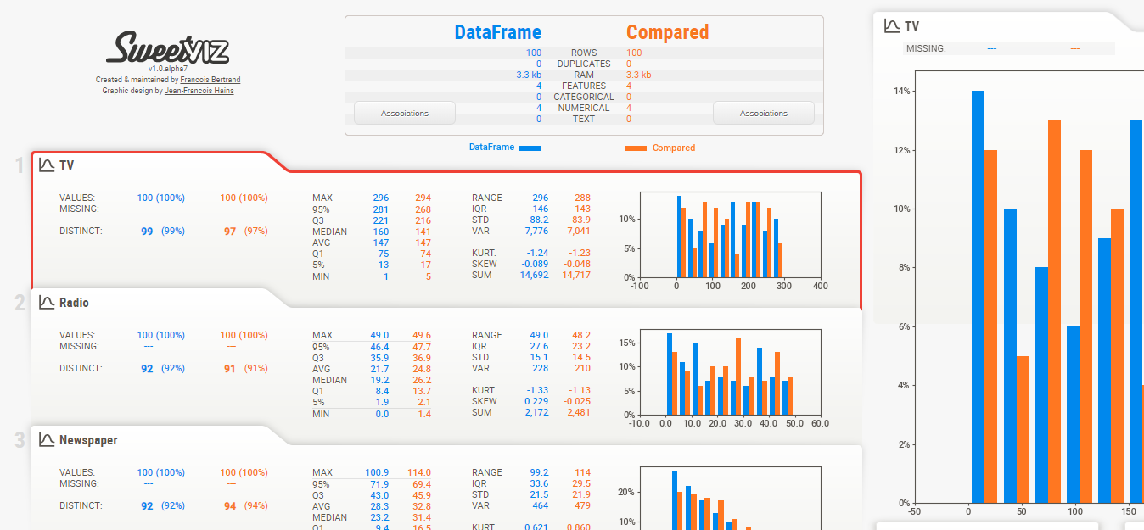
Automated EDA
Modules: pandas_profiling,AutoViz,summarytools

Slide 20
Python
Notes:
Guidelines
Use a title slide at the beginning of your presentation. There are 9 variations of title slides to choose from.
If you will have a series of slideshows, we recommend using the same style of title slide for each presentation.
Keep your title to no more than 2 lines.
Do not change the font style or font size of the title or subtitle.

